Slide 1
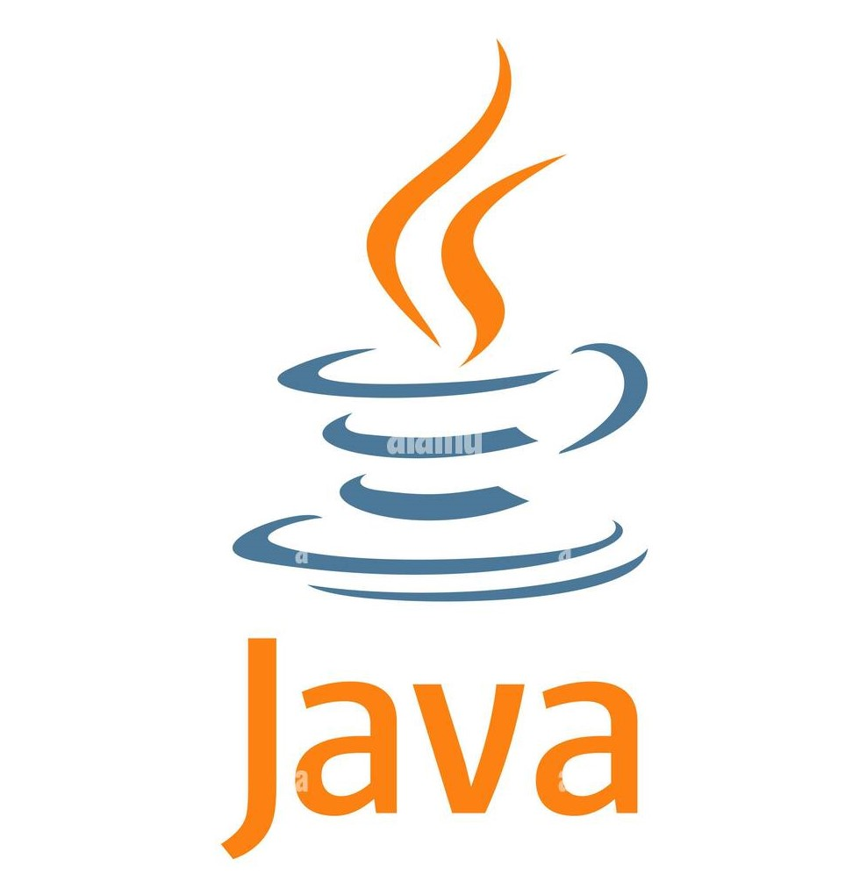
Java Architecture Exploring the Components and Execution Flow

Slide 2
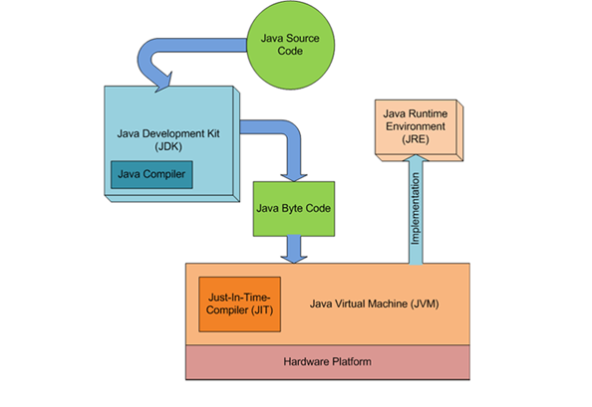
Introduction to Java Architecture
Java is a platform-independent, object-oriented programming language.
Its architecture is designed to ensure "write once, run anywhere" functionality.
Three main components: JDK (Java Development Kit), JRE (Java Runtime
Environment), JVM (Java Virtual Machine).

Slide 3
Java Development Kit (JDK)
Purpose:
Tools and libraries for Java application development.
Components:
javac (compiler) : Transforms Java code into bytecode.
java (launcher) : Runs Java applications.
Additional tools:
javadoc, jconsole, and debugging tools.
Role:
Essential for development, not needed solely for execution.

Slide 4
Java Runtime Environment (JRE)
Purpose: Executes Java applications.
Components:
Core libraries and APIs.
JVM, which interprets/compiles bytecode.
Role:
For running Java programs, providing runtime libraries and JVM.

Slide 5
Java Virtual Machine (JVM)
Purpose: Converts bytecode into machine-specific code, enabling platform
independence.
Key Components of JVM:
Class Loader: Loads classes into memory.
Runtime Data Area: Manages memory for code, data, and execution.
Execution Engine: Interprets or JIT-compiles bytecode for execution.
Key Feature:
Makes Java platform-independent.

Slide 6
Java Program Flow - Compilation and Execution
Step-by-Step Flow:
Write Source Code (.java file).
Compilation to bytecode (.class file) using javac.
Execution by JVM, interpreting or JIT-compiling bytecode.
Platform Independence:
Bytecode can run on any machine with JVM.

Slide 7
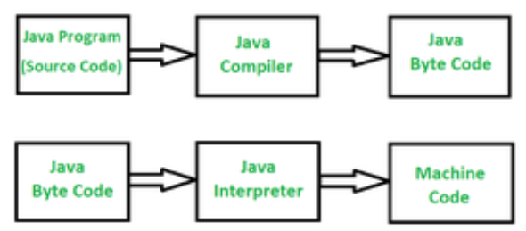
Compilation vs. Interpretation in Java
Compilation: Source code (.java) is compiled into platform-independent bytecode (.class).
Interpretation: JVM interprets bytecode into machine code.
Just-In-Time (JIT) Compilation: Optimizes frequently used code segments into machine code for better performance.

Slide 8
Advantages of Java Architecture
Platform Independence: "Write once, run anywhere" capability.
Security: Sandboxed environment and secure class loading.
Robustness: Built-in garbage collection, exception handling.
Performance: JIT compilation and efficient memory management enhance speed.

Slide 9
Real-World Applications of Java
Enterprise Applications: Banking and large-scale e-commerce.
Android Development: Core of Android application development.
Scientific Applications: Used in big data and machine learning.
Web Development: Popular frameworks (e.g., Spring, Hibernate).

Slide 10
Thank You

